Slide 1


Department of Artificial Intelligence and Data
Science
Finance & Banking
Credit Scoring with Alternate Data
Bharkavi N (231801023) Gayathri R (231801039)
Hemalatha L(231801055)
Dr. Suresh Kumar

Slide 2

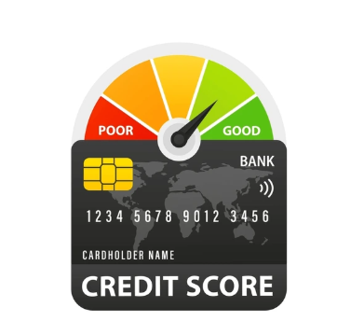
Introduction
Need for Smarter Credit Scoring:
Traditional models rely on limited financial history
Underbanked customers often excluded
Manual scoring is slow and lacks adaptability
Project Motivation & Objectives:
Automate credit scoring using Big Data and ML
Integrate alternative data sources for better accuracy
Provide banks with actionable insights via dashboards
Department of Artificial Intelligence and Data
Science

Slide 3

Abstract
Problem Overview:
Static rule-based models fail to capture dynamic behavior
Limited support for real-time data and fraud detection
Proposed Solution:
A Big Data pipeline built in Databricks
Uses Spark, HiveQL, and Python for processing
Random Forest model predicts creditworthiness and fraud
Dashboards visualize trends and outcomes
Department of Artificial Intelligence and Data
Science

Slide 4

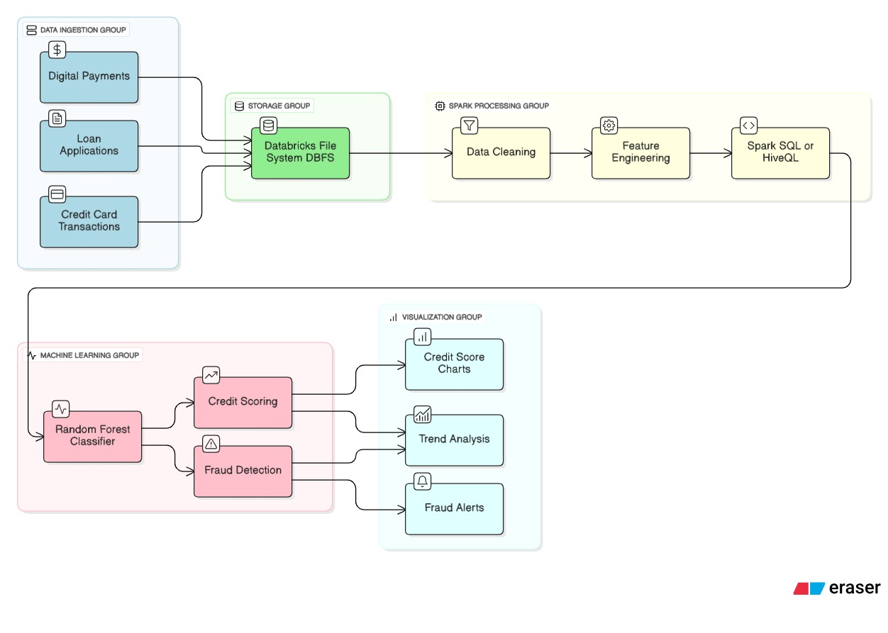
Architecture
4

Slide 5
Modules Overview
Data Ingestion: Upload via Databricks wizard
Preprocessing: Handle missing values, clean data
Feature Engineering: Lag features, rolling averages, holiday flags
Modeling: Train Random Forest classifier
Visualization: Interactive dashboards for decision-making
Department of Artificial Intelligence and Data
Science
5

Slide 6

Tools Used
Databricks: Unified analytics platform
Apache Spark: Distributed data processing
HiveQL: SQL-style querying
Python Libraries:
Pandas – Data manipulation
Scikit-learn – ML modeling
Matplotlib/Seaborn – Visualizations
Dashboard: Built using Databricks notebooks
Department of Artificial Intelligence and Data
Science
6

Slide 7
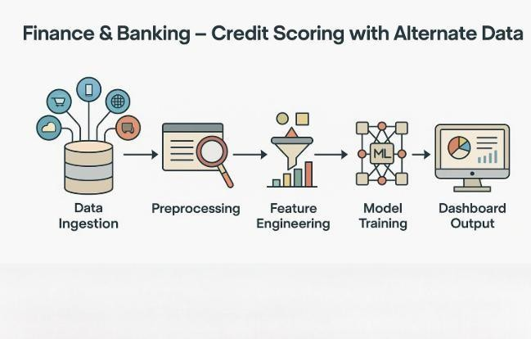
Implementation
Steps:
Upload dataset via Databricks
Preprocess and engineer features using Python
Train Random Forest model
Evaluate using metrics like precision, recall
Build dashboards to display predictions and trends
7

Slide 8
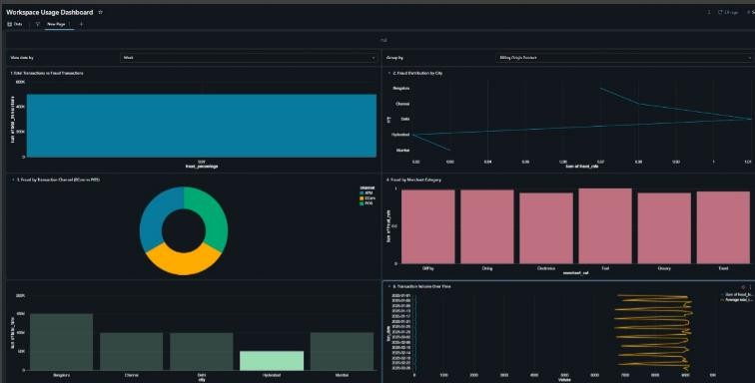
Dashboard Visualization
Credit score distribution
Fraud risk flags
Feature importance chart
Time-based prediction trends
Department of Artificial Intelligence and Data
Science
8

Slide 9
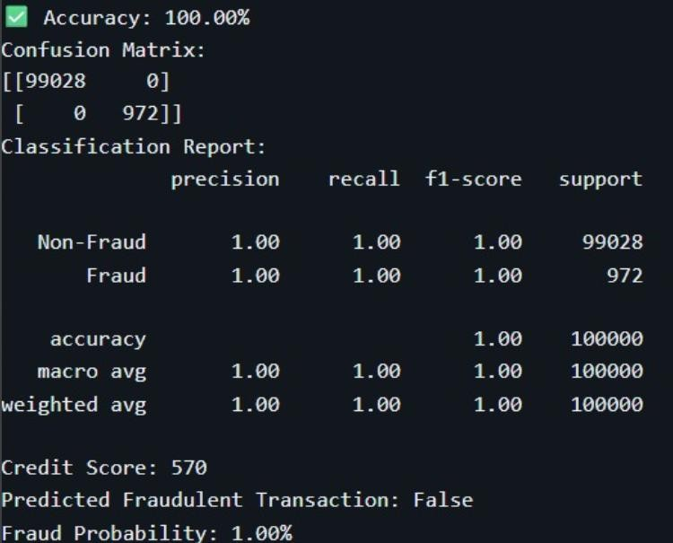
Results
Model Performance:
Accuracy: 100%
Fraud probability: probability of fraud
Credit scoring: Improved for thin-file
customers
Insights:
Helps banks allocate credit more fairly
Flags high-risk customers for review
Enables data-driven lending decisions
9

Slide 10
Conclusion & Future Scope
Conclusion:
Efficient, scalable credit scoring system
Combines Big Data and ML for smarter decisions
Future Enhancements:
Add more models (XGBoost, SVM)
Integrate real-time transaction feeds
Expand to loan approvals and financial profiling
Improve fairness and interpretability

Slide 11
References
Databricks Documentation – Big Data & Machine Learning https://docs.databricks.com/en/machine-learning/index.html Apache Spark Official Documentation https://spark.apache.org/docs/latest/
UCI Machine Learning Repository – Credit Scoring Datasets https://archive.ics.uci.edu/ml/datasets/statlog+(german+credit+data) Kaggle – Credit Card Fraud Detection Dataset https://www.kaggle.com/datasets/mlg-ulb/creditcardfraud
Scikit-learn: Machine Learning in Python
https://scikit-learn.org/stable/
World Bank Open Data – Financial Inclusion Indicators https://data.worldbank.org/topic/financial-sector
Research Paper: “Credit Scoring Using Machine Learning Techniques – A Review”
https://www.sciencedirect.com/science/article/pii/S2405452619300053

Slide 12
Thank You

